Slide 1
OMNeT++ Simulation Project
Dylan White
Gus Ellerm

Slide 2
Difficulties
Cross-platform development
  Default makefile configuration
  File naming
Makefiles
  IDE vs. command line
  Dynamic linking
Memory management
  Deleting message objects
  Destructors
RNG
  Seed generation

Slide 3
Testing
Visual debugging
  Checking message sequencing makes sense
Valgrind – memcheck
  Checking for non-obvious memory leaks
Testing boundry cases
  Behaviour of system with 45 TX
GDB debugger
  Finding exact locations simulation was breaking
  Using Omnets FSM debugger output
Analysing statistics
  Are the results explainable?
  Do they make sense?

Slide 4
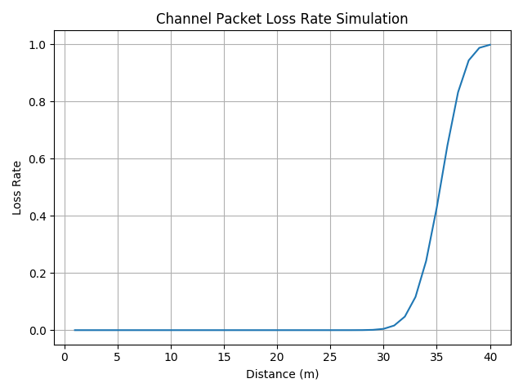
Channel Packet Loss Rate

Slide 5
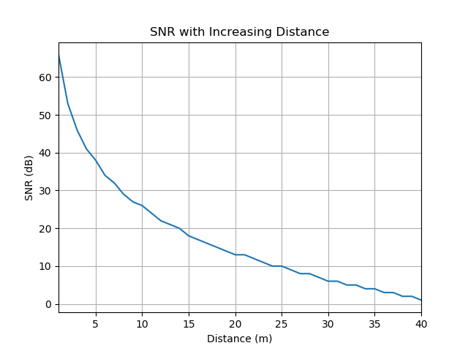
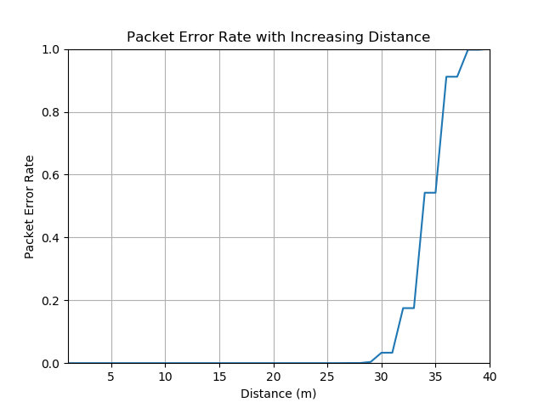
Channel Packet Loss Rate

Slide 6
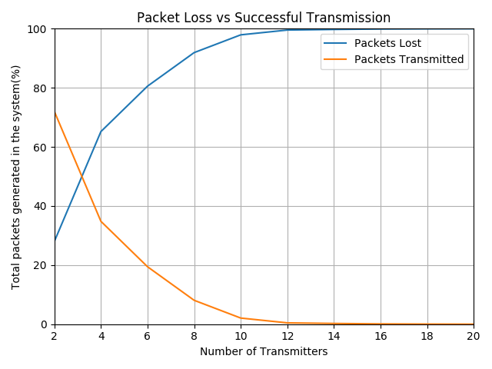
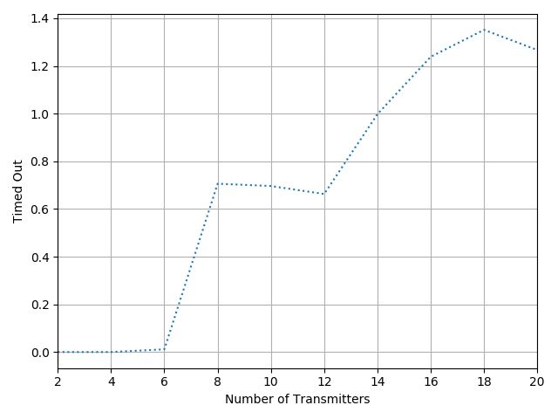
MAC Packet Loss Rate

Slide 7
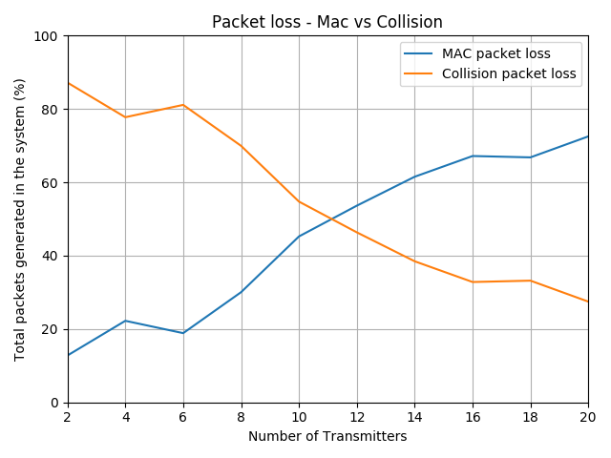
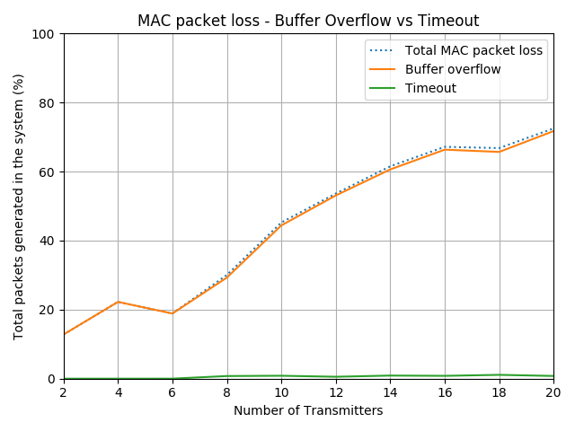
MAC Packet Loss Rate

